Slide 1

MIABIS as a modular system
David van Enckevort
david.van.enckevort@umcg.nl

Slide 2
MIABIS 2.0
Core modules:
  Biobanks
  Sample collections
  Studies
Modules under development:
  Patients
  Samples
  Sample quality
  Experiments (-omics)
  Rare diseases

Slide 3
Why use a modular system?
Different use cases:
  Biobank catalogue – summary information
  Study catalogue – information per sample
  Availability catalogue – counting samples via filtering
  Workflow system for sample / data set request
  Biobank Information System – operational support
  Publication – minimum information for in the paper

Slide 4

Biobank Information Data Pyramid
Study name
Contact info Collection type
MIABIS Core
MIABIS Core + additional components
Descriptive
data
Age high, Age low, Sex, Material type, Data categories , Disease(s) etc.
Aggregated data
LIMS
Sampled date, storage temp., Material type, Disease, Age
Sample and donor data
Notes:
4

Slide 5
Biobanks (Core)
Definition¹:
  "Collections, repositories and distribution centres of all types of human biological samples, such as blood, tissues, cells or DNA and/or related data such as associated clinical and research data, as well as biomolecular resources, including model- and microorganisms that might contribute to the understanding of the physiology and diseases of humans" (BBMRI-ERIC)
  "An organized collection of human biological material and associated information stored for one or more research purposes" (P3G)
Defines the organisation: juristic person, contact person
¹Fransson MN et al. Toward a common language for biobanking., Eur J Hum Genet. 2014 Apr 9. doi: 10.1038/ejhg.2014.45

Slide 6
Sample Collections (Core)
Definition¹:
  "A collection of samples with at least one common characteristic" (Swedish Association of Local Authorities and Regions)
  "A number of samples collected or gathered together, viewed as a whole" (Oxford English Dictionary)
Defines common characteristics of a collection

Slide 7
Studies (Core)
Definition¹:
  "A detailed examination, analysis or critical inspection of a subject designed to discover facts about it" (NCI)
Defines common characteristics used in the study

Slide 8
Additional components (proposal)
Participant
  Donor of the sample
Sample
  Sample and the anatomical source of the sample
Sample Quality
  Quality parameters of the sample
Experiment (OMICS)
  Experiments performed on samples
Rare Disease
  Additional properties used in rare disease studies

Slide 9
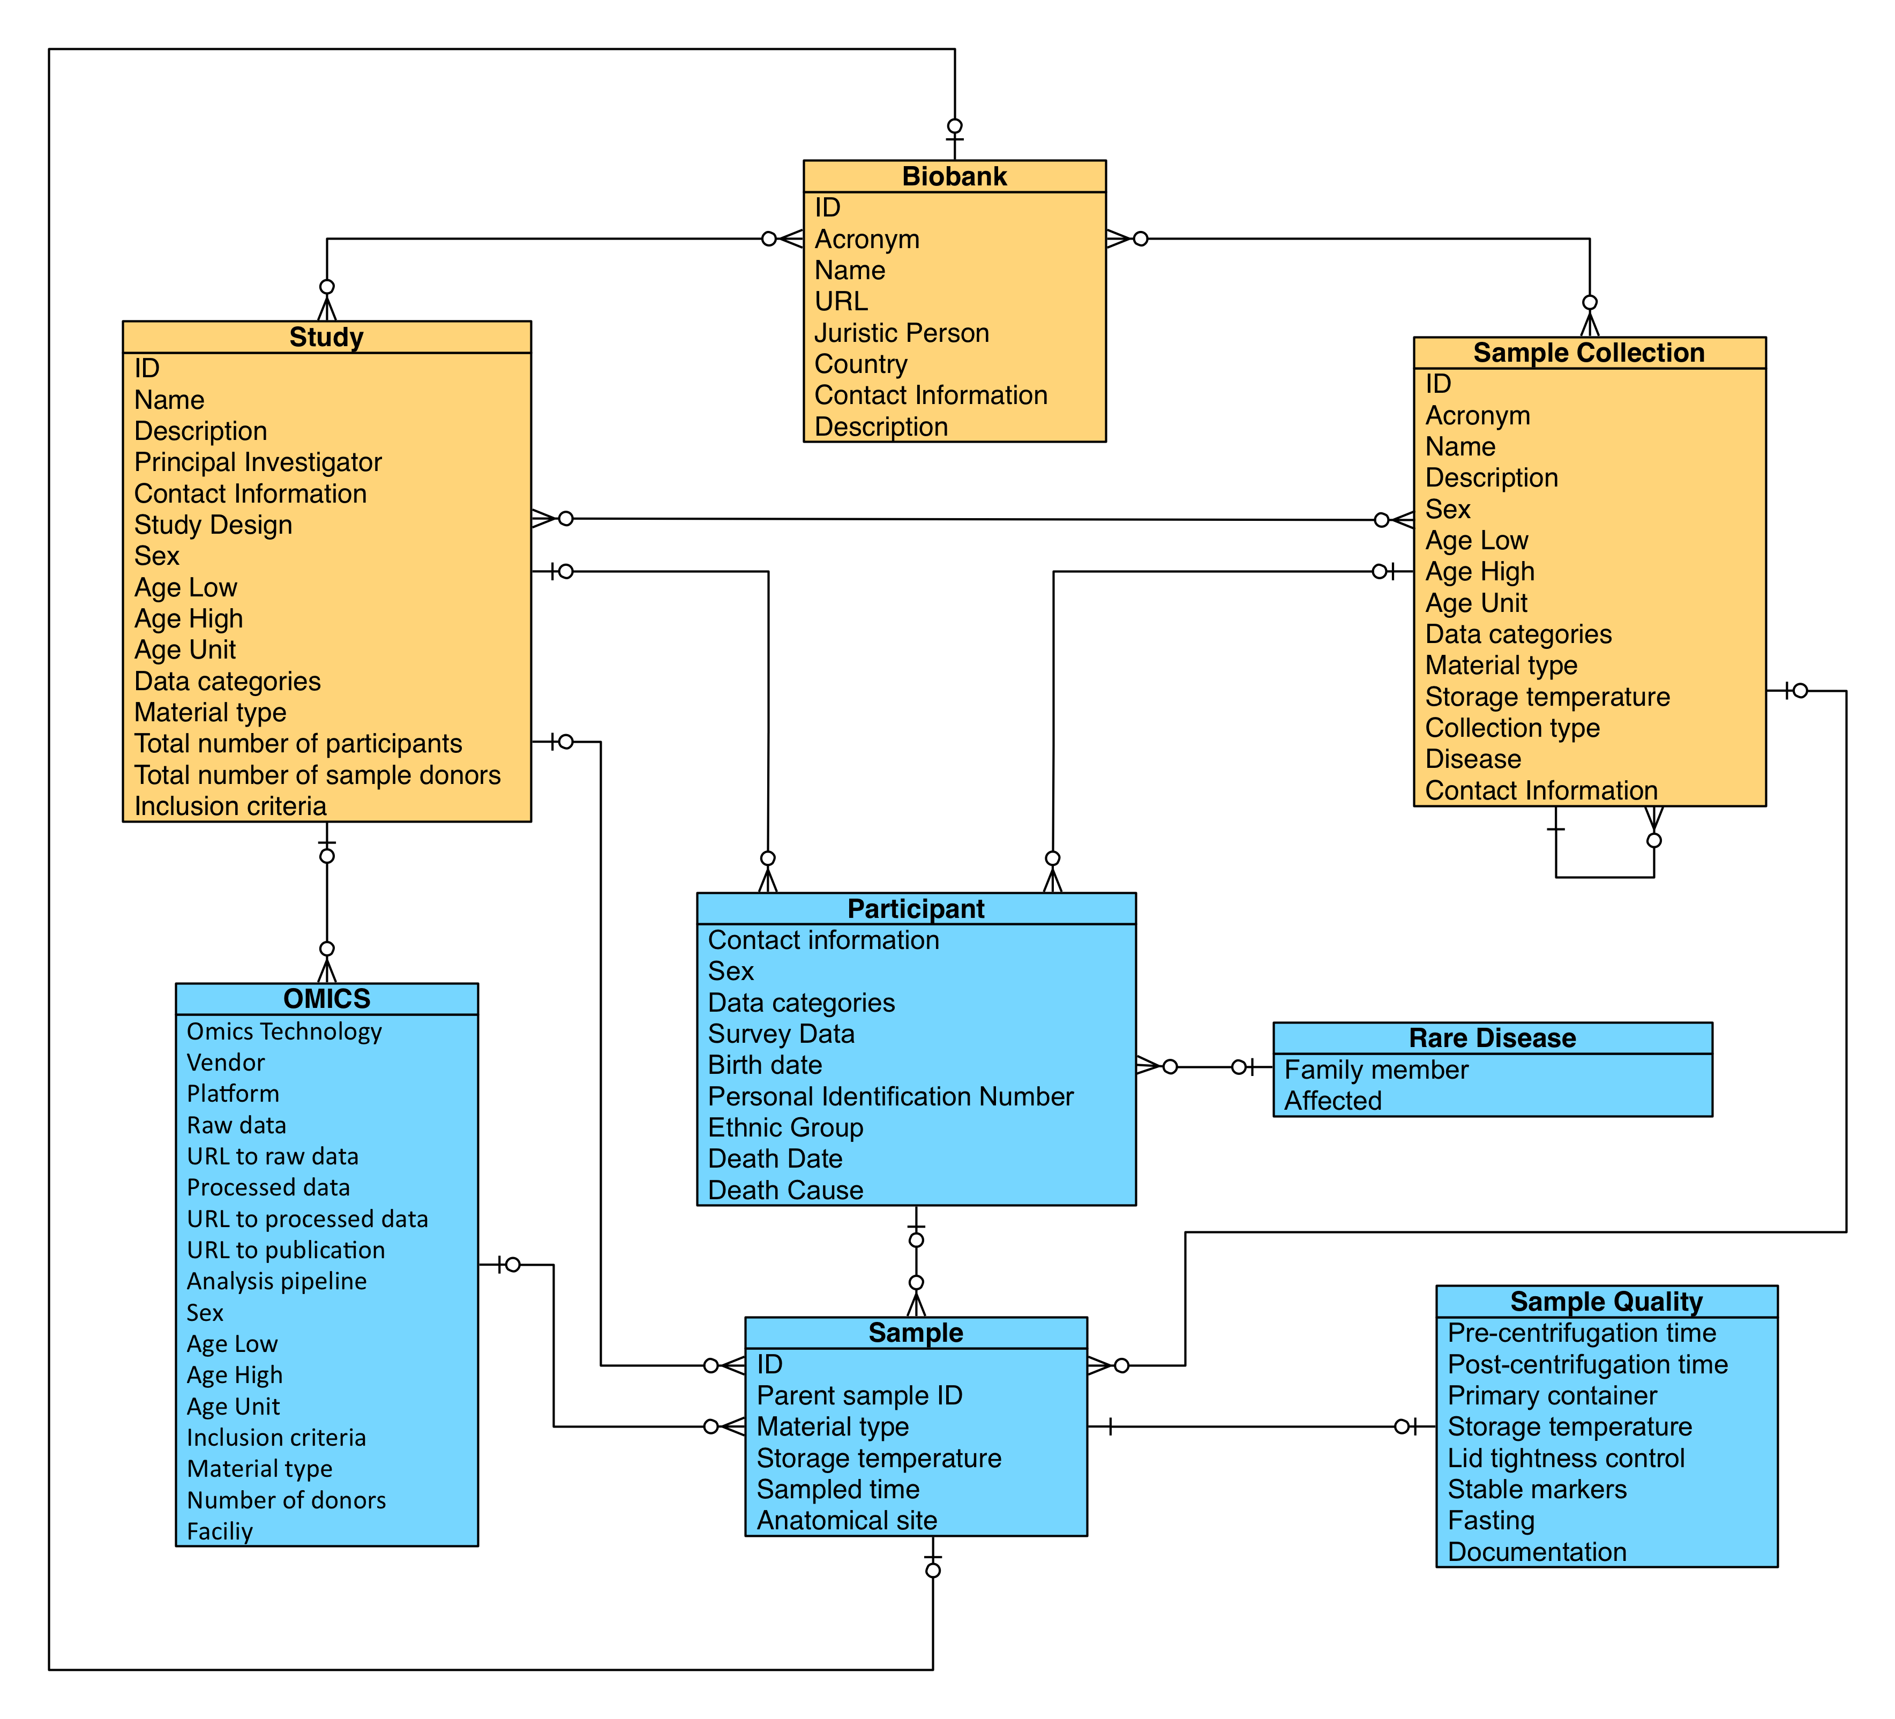
MIABIS 2.0 diagram (simplified)

Slide 10
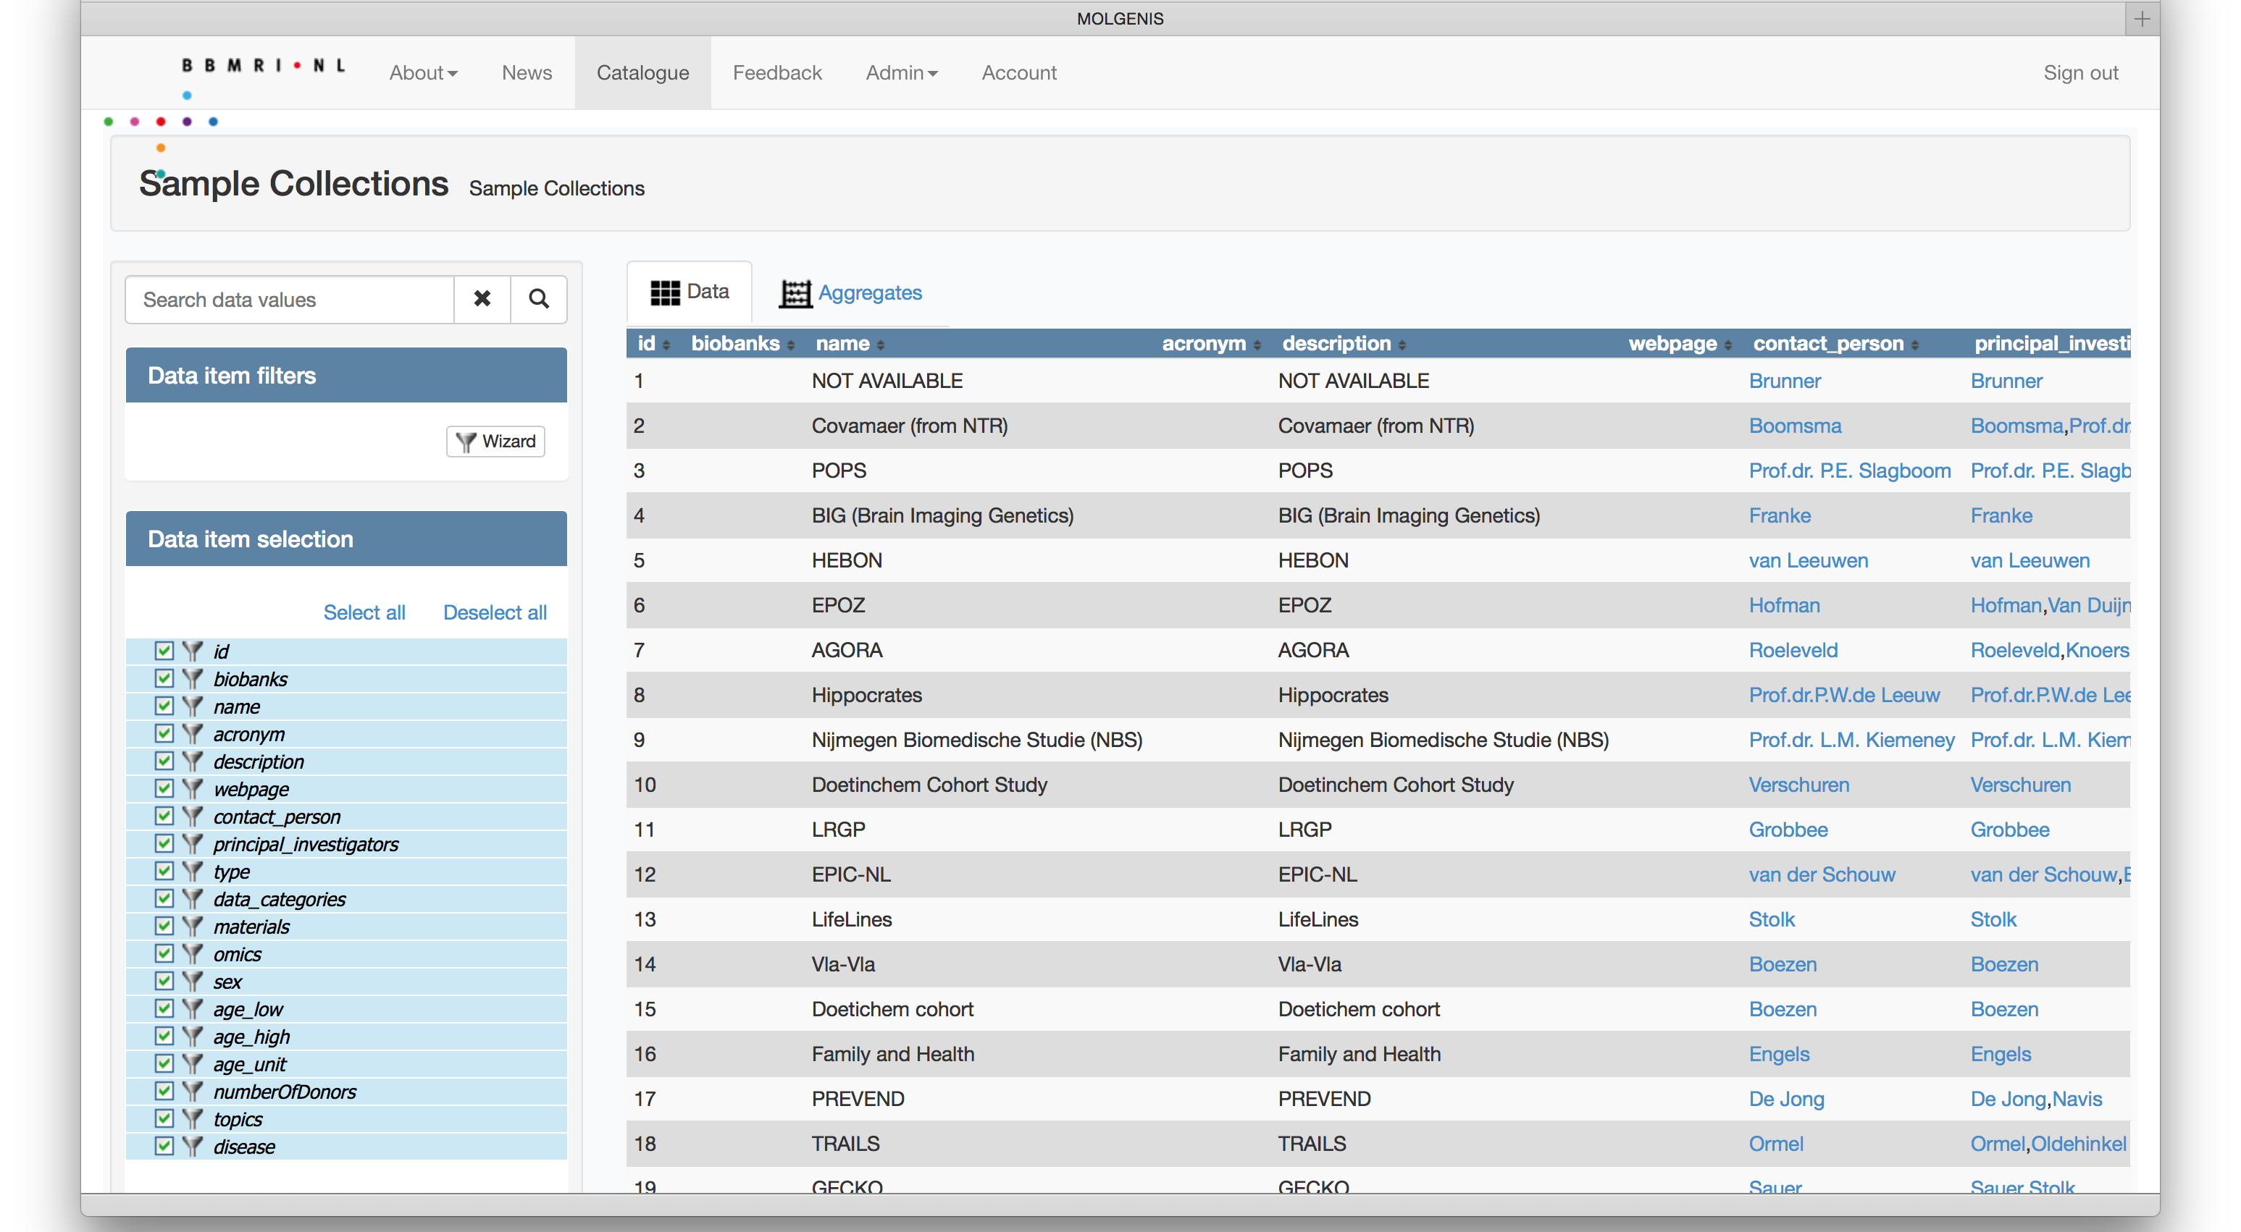
Use Case Biobank Catalogue
Notes:
A catalogue gives a high level overview of the available sample collections
Use cases for a catalogue:
Cohort selection
Policy making: e.g. decision on focus for a biobank based on relative strength and weaknesses.

Slide 11
Use Case Biobank Catalogue
Study name
Contact info Collection type
MIABIS Core
MIABIS Core + additional components
Descriptive
data
Age high, Age low, Sex, Material type, Data categories , Disease(s) etc.
Aggregated data
LIMS
Sampled date, storage temp., Material type, Disease, Age
Sample and donor data
Notes:
Catalogue is descriptive, but might also contain (coarse) aggregated data
11

Slide 12
Use Case Biobank Catalogue
Notes:
Uses the core modules: biobank and sample collection, might also use study and experiments

Slide 13
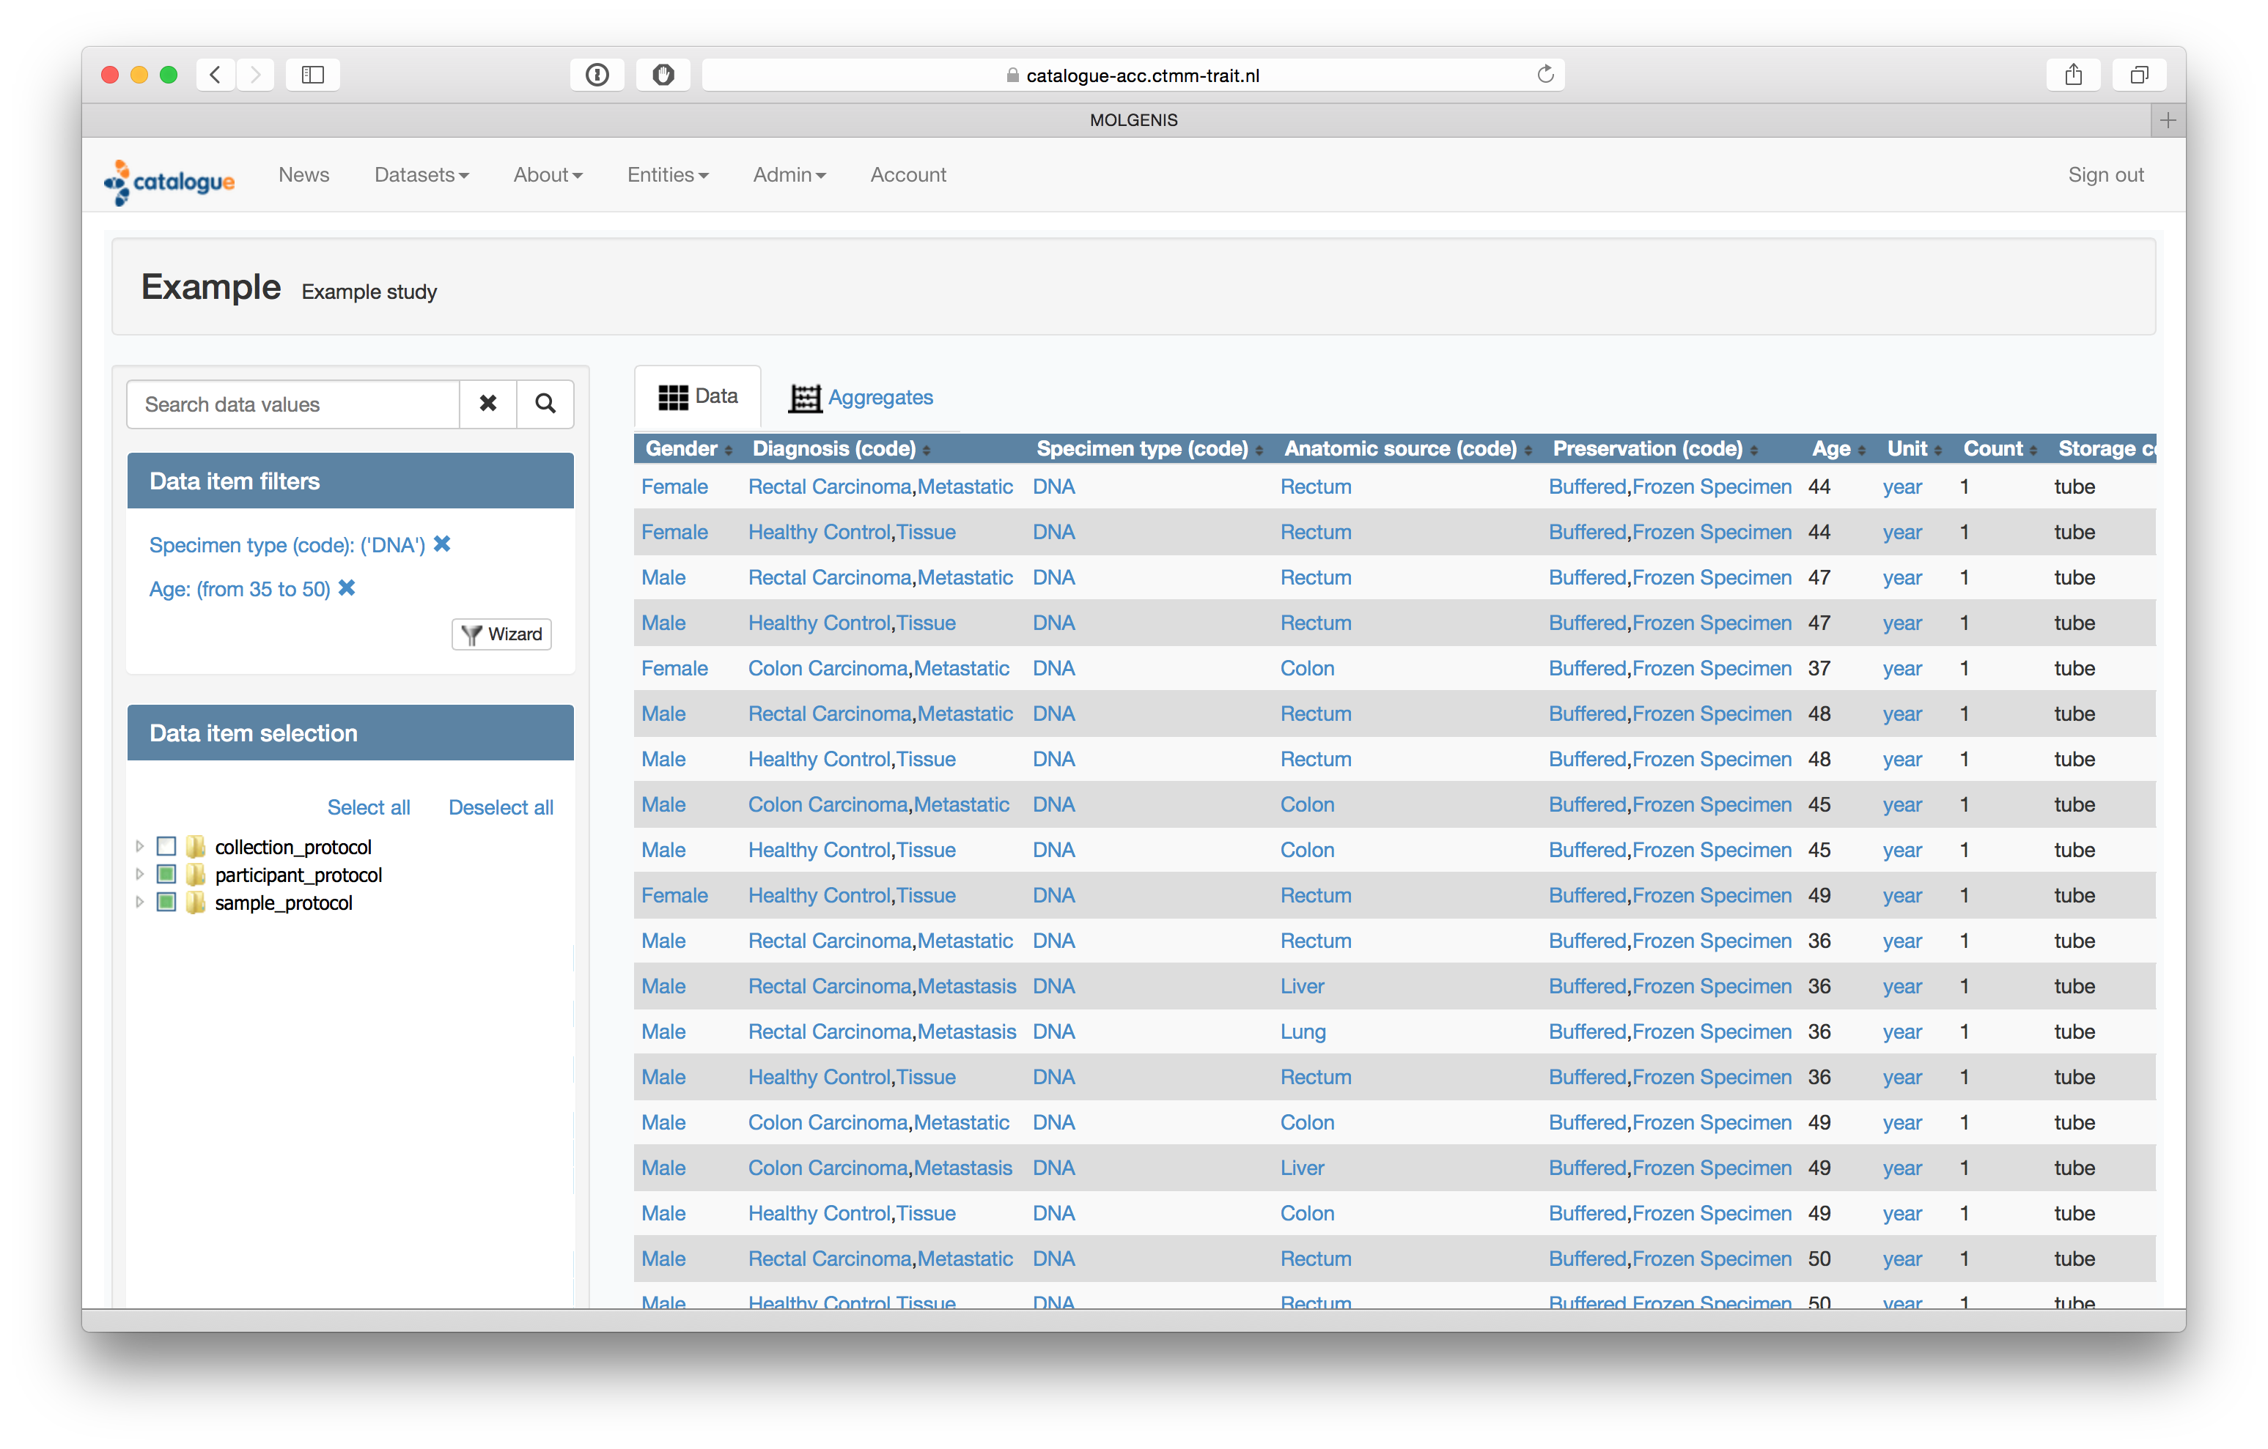
Use Case Study Catalogue
Notes:
Detailed catalogue of available samples within a study:
source for researchers to find their samples
source for PI to monitor the progress of the collection building and usage
Example: TraIT, RD-Connect

Slide 14
Use Case Study Catalogue
Study name
Contact info Collection type
MIABIS Core
MIABIS Core + additional components
Descriptive
data
Age high, Age low, Sex, Material type, Data categories , Disease(s) etc.
Aggregated data
LIMS
Sampled date, storage temp., Material type, Disease, Age
Sample and donor data
Notes:
Focus is on the individual sample and donor data, but the descriptive and aggregated data is used as well
14

Slide 15
Use Case Study Catalogue
Notes:
Uses the full model and might have a more detailed model

Slide 16
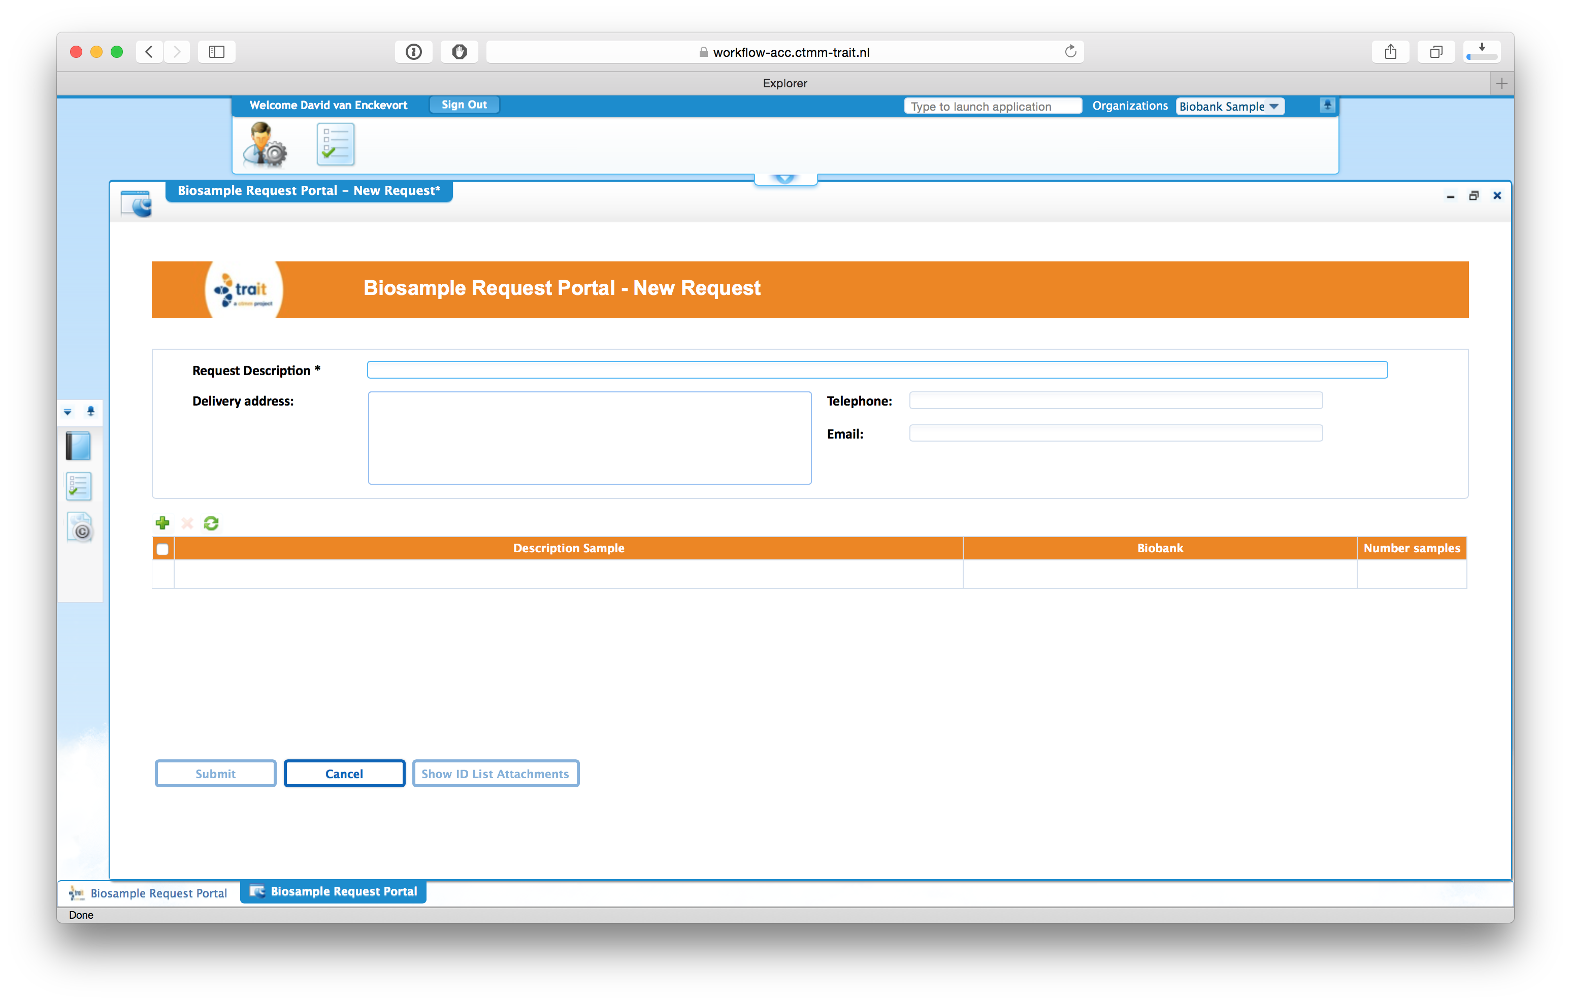
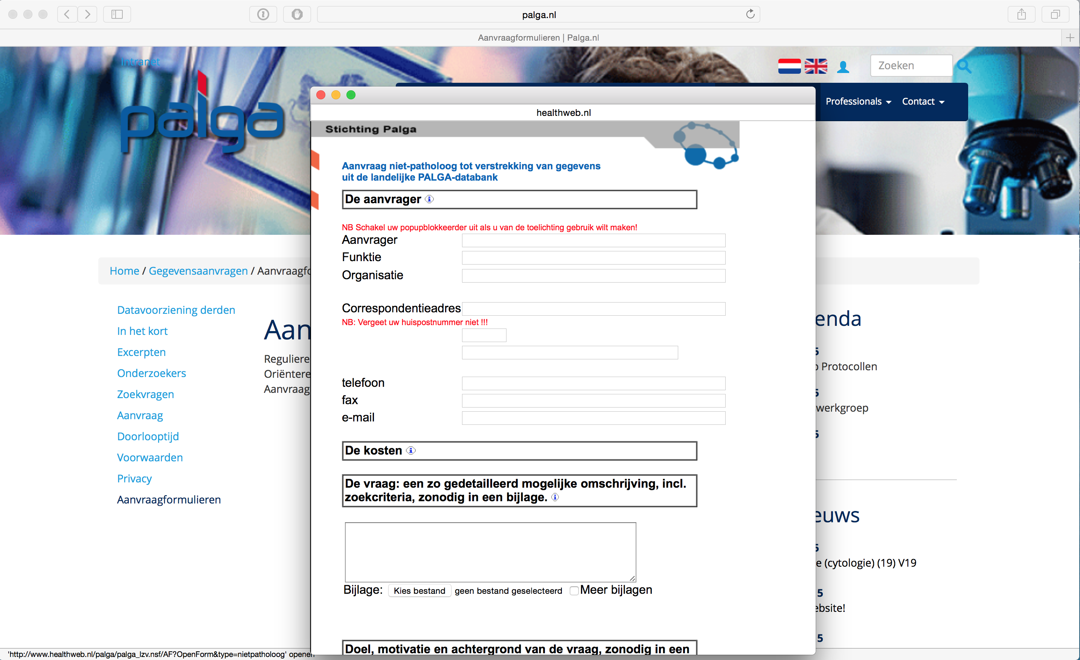
Use case Sample Request Workflow
Notes:
A workflow that monitors the process of sample request from the initial request until the sample shipment, deals with biobanks and individual samples
Examples: TraIT, Parelsnoer, Palga

Slide 17
Use case Sample Request Workflow
Study name
Contact info Collection type
MIABIS Core
MIABIS Core + additional components
Descriptive
data
Age high, Age low, Sex, Material type, Data categories , Disease(s) etc.
Aggregated data
LIMS
Sampled date, storage temp., Material type, Disease, Age
Sample and donor data
Notes:
Uses biobank or sample collection module for contact details
Uses sample data
17

Slide 18
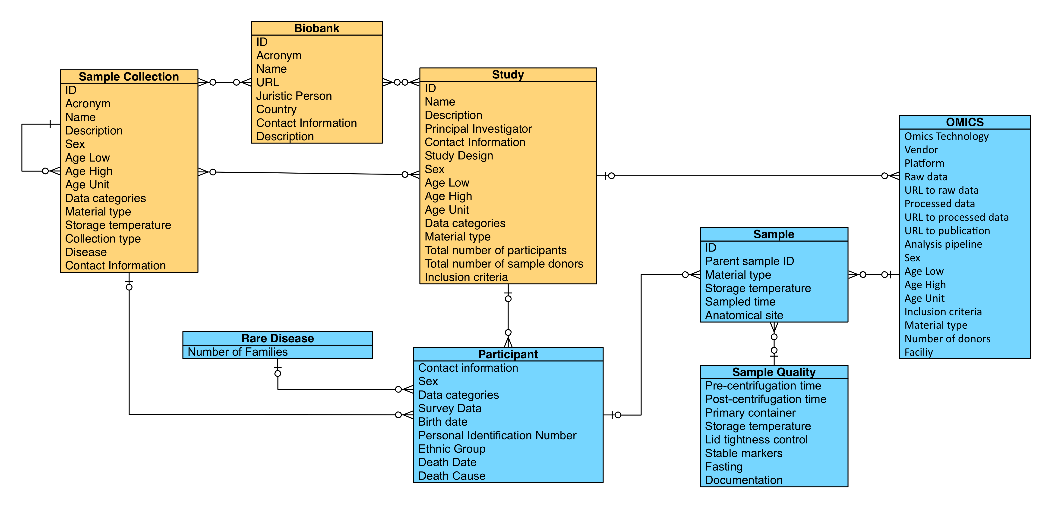
Use case Sample Request Workflow
Notes:
Uses biobank or sample collection module for contact details
Uses sample data

Slide 19
Use case Biobank Information System
IDQuest
OpenSpecimen

Slide 20
Use case Biobank information system
Study name
Contact info Collection type
MIABIS Core
MIABIS Core + additional components
Descriptive
data
Age high, Age low, Sex, Material type, Data categories , Disease(s) etc.
Aggregated data
LIMS
Sampled date, storage temp., Material type, Disease, Age
Sample and donor data
Notes:
Biobank Cloud
20

Slide 21
Use case Biobank Information System

Slide 22
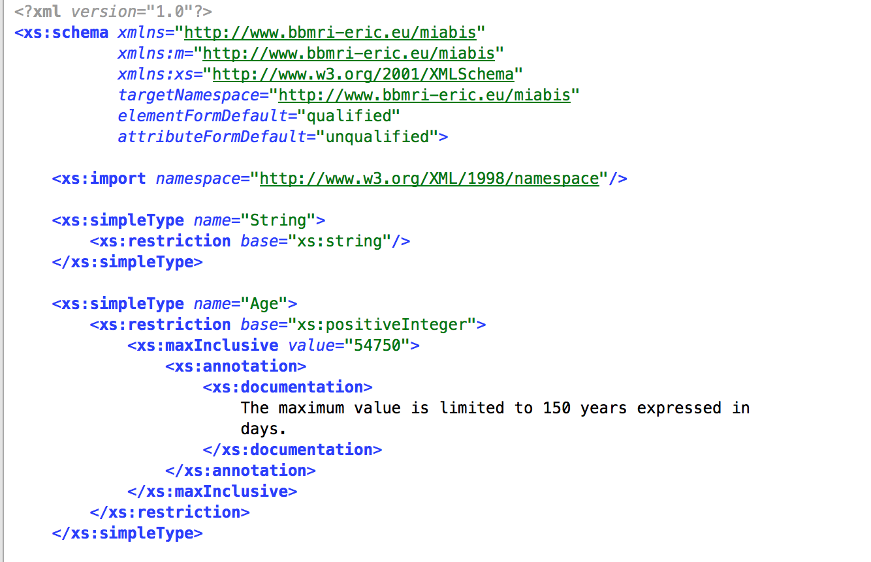
Implementation
Working on programmatic interfaces: XML schema definition

Slide 23
Conclusions
MIABIS is tested in real life applications
Different use cases can use different modules of MIABIS
Standardized modules makes it easier to create interchangeable software

Slide 24
Acknowledgements
MIABIS working group: Linda Mook, Roxana Merino-Martinez, Loreana Norlin, Gabriele Anton, Simone Schuffenhauer, Kaisa Silander, Anita Nieminen Roman Siddiqui, Murat Sariyar, Michael Hummel, Cathleen Ploetz Raffael Bild, Helmut Spengler, Heimo Müller, Linda Zaharenko, Araceli Diezfraile, Joakim Geeraert, Petr Holub, Ondra vojtisek, Kristjan Metsalu,Martin Fransson, Michaela Mayrhofer, Morris Swertz, Klaus Kuhn, Jan-Eric Litton
CTMM TraIT: Peter Lansberg, Linda Mook, Erik van Iperen, Cuneyt Parlayan, Tim Hulsen
Parelsnoer Institute: Erik Flikkenschild, Gerhard Zielhuis, René Oostergo, Ariaan Siezen
BBMRI-NL: Margot Heesakker, Petra van Overveld, Margreet Brandsma, Mascha Jansen
Palga / DNTP: Chantal Steegers, Lucy Overbeek, Arne Hoffman
Notes:
Linda Mook: modularisation
Roxana: Practical application
Loreana: Lead

