Slide 1
MOLGENIS & FAIR DATA
David van Enckevort
david.van.enckevort@umcg.nl
Montréal, 23 May 2017

Slide 2
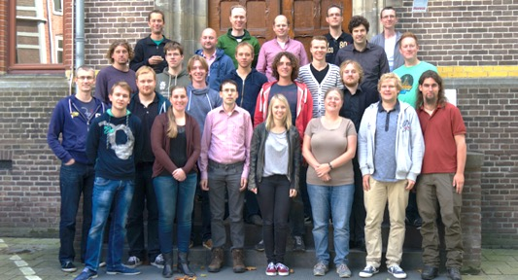
Introduction
Project Manager
Genomics Coordination Centre at Dept. Genetics
Member of the group lead by Prof. M.A. Swertz
My focus: sharing of biobank data and material

Slide 3
Outline
MOLGENIS
FAIR Principles

Slide 4
MOLGENIS
Platform for Scientific Data

Slide 5
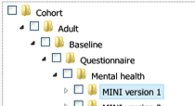
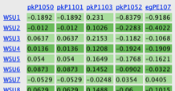
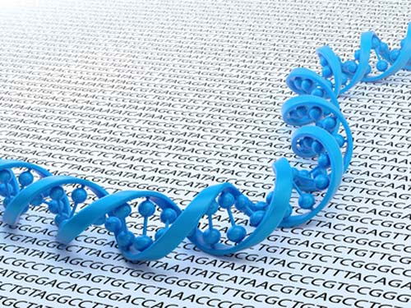
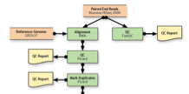
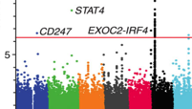
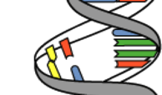
Platform for scientific data
Upload format
Import data and meta data using EMX format
Data request
Find and request (biobank) data sets and items
Data explorer
Filter and download for further analysis
Genome browser
Data sharing and integration DAS protocol
Model registry
Meta-data registry of models for biobanks and molecular data
Annotators
Data integration for diagnostics and personalized
medicine
Connect
Harmonisation tools
R statistics
Use R data API to up/download data and integrate graphics
Compute
Large scale computation on computational clusters, grids and clouds
Impute pipeline
GWAS harmonization and imputation
DNA pipeline
NGS data alignment, SNV/SV calling, QC, NIPT
RNA pipeline
NGS data quantitation, structure, eQTL allele specific expression
http://www.molgenis.org/

Slide 6
Pipelines
Build for large scale computational tasks
Define a template pipeline and run file defining the data
Submit to cluster, GRID
Monitor results in MOLGENIS web interface

Slide 7
Data presentation
Allow for user interaction with data
Filtering
Basic statistics
Customisable presentation with FreeMarker templates and the ‘App store’ (MOLGENIS 4)

Slide 8
Data ingest and harmonisation
Offer easy upload of data
Manual Excel, VCF, CSV upload
Scheduled upload
REST API
Standardize and harmonize data and data models
Mapping Service, BiobankConnect, SORTA

Slide 9
MOLGENIS/connect toolbox
‘FAIRifier’ system for retrospective interoperability of data
Biobank
Connect
Make data attributes interoperable
<ID> | <ID> | <ID> | <ID> | <ID>
<ID> | <ID> | <ID> | <ID> | <ID>
<ID> | <ID> | <ID> | <ID> | <ID>
<ID> | <ID> | <ID> | <ID> | <ID>
<ID> | <ID> | <ID> | <ID> | <ID>
<ID> | <ID> | <ID> | <ID> | <ID>
<ID> | <ID> | <ID> | <ID> | <ID>
<ID> | <ID> | <ID> | <ID> | <ID>
<ID> | <ID> | <ID> | <ID> | <ID>
SORTA
Make data values interoperable

Slide 10
Code data to a common standard
Identifiers, ontologies, codes
<ID> | <ID> | <ID> | <ID> | <ID>
<ID> | <ID> | <ID> | <ID> | <ID>
<ID> | <ID> | <ID> | <ID> | <ID>
<ID> | <ID> | <ID> | <ID> | <ID>
<ID> | <ID> | <ID> | <ID> | <ID>
<ID> | <ID> | <ID> | <ID> | <ID>
<ID> | <ID> | <ID> | <ID> | <ID>
<ID> | <ID> | <ID> | <ID> | <ID>
<ID> | <ID> | <ID> | <ID> | <ID>

Slide 11
SORTA
<ID> | <ID> | <ID> | <ID> | <ID>
<ID> | <ID> | <ID> | <ID> | <ID>
<ID> | <ID> | <ID> | <ID> | <ID>
<ID> | <ID> | <ID> | <ID> | <ID>
<ID> | <ID> | <ID> | <ID> | <ID>
<ID> | <ID> | <ID> | <ID> | <ID>
<ID> | <ID> | <ID> | <ID> | <ID>
<ID> | <ID> | <ID> | <ID> | <ID>
<ID> | <ID> | <ID> | <ID> | <ID>
SORTA
Make data values interoperable

Slide 12
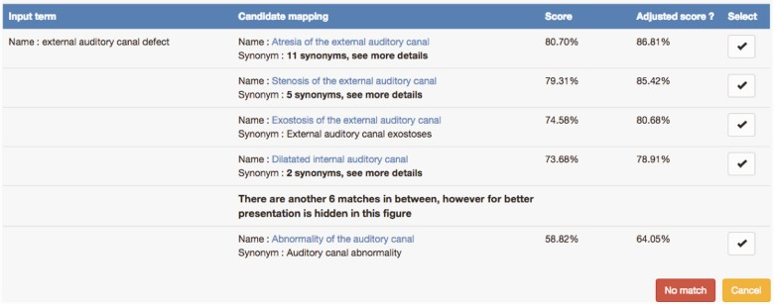
SORTA Workflow
Upload data using Excel
SORTA shortlists candidate codes
Lexical matching
Semantic matching
Use n-gram matching treshold (e.g 80%)
SORTA automatically recodes when high matching score (e.g. 80%)
Human expert decides (and so trains SORTA)

Slide 13
Expert curation of the matches

Slide 14
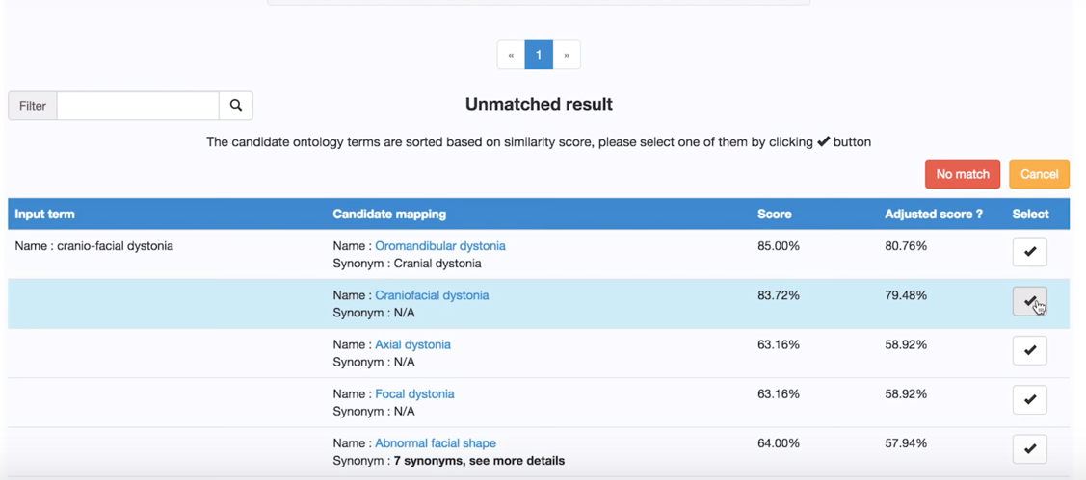
Expert curation of the matches
Original text

Slide 15
Expert curation of the matches
Candidate standardized terms

Slide 16
Expert curation of the matches
Confidence scores

Slide 17
Expert curation of the matches
Select the right match

Slide 18
BiobankConnect
Biobank
Connect
Make data attributes interoperable
<ID> | <ID> | <ID> | <ID> | <ID>
<ID> | <ID> | <ID> | <ID> | <ID>
<ID> | <ID> | <ID> | <ID> | <ID>
<ID> | <ID> | <ID> | <ID> | <ID>
<ID> | <ID> | <ID> | <ID> | <ID>
<ID> | <ID> | <ID> | <ID> | <ID>
<ID> | <ID> | <ID> | <ID> | <ID>
<ID> | <ID> | <ID> | <ID> | <ID>
<ID> | <ID> | <ID> | <ID> | <ID>

Slide 19
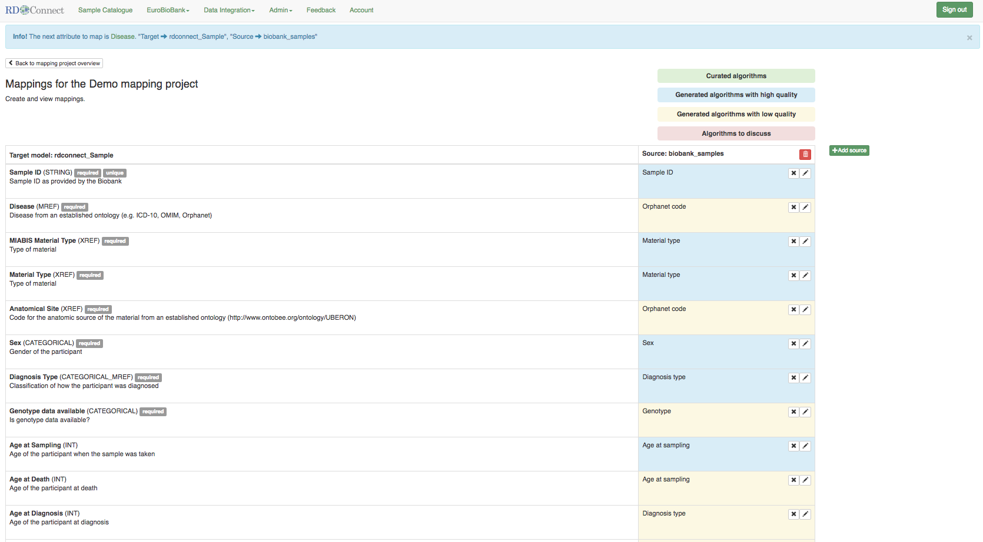
Software generates mappings
Standard model to conform to

Slide 20
Software generates mappings
Mapping rules for your data

Slide 21
Software generates mappings
Mapping rules for your data
You can map multiple datasets

Slide 22
Software generates mappings
Colour indicates state of the mapping

Slide 23
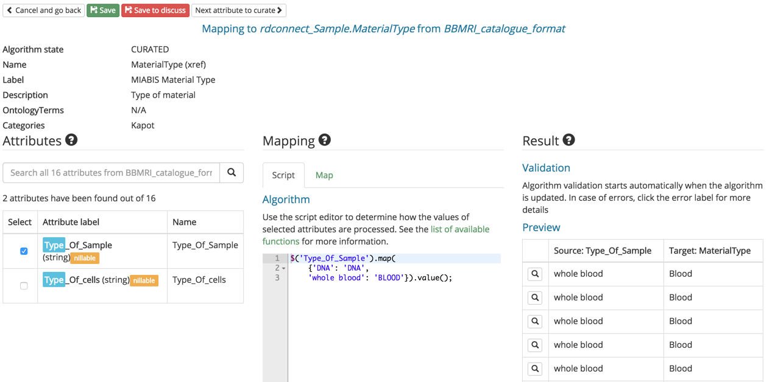
Curation of mappings

Slide 24
Curation of mappings
Create rules for conversion

Slide 25
Curation of mappings
On the fly validation

Slide 26
Curation of mappings
Mark mapping as:
Curated
To be discussed

Slide 27
Benefits
Tools reduce the burden of harmonising data
Easier to adopt standardized terminology
Allowing expert curation to provide high quality data
Make data usable for pooling and aggregation

Slide 28
FAIR Principles
Make resources sustainable for reuse
Findability
Accessibility
Interoperability
Reusability
doi: 10.1038/sdata.2016.18

Slide 29
Findable
Resources are assigned a globally unique and persistent identifier
Resources are described with rich metadata
Metadata clearly and explicitly include the identifier of the resource it describes
Resource can by found through other systems

Slide 30
Accessible
Retrievable by their identifier using a standardized communications protocol
The protocol is open, free, and universally implementable
The protocol allows for an authentication and authorization procedure, where necessary
Metadata are accessible, even when the data are no longer available

Slide 31
Interoperable
Use a formal, accessible, shared, and broadly applicable language for knowledge representation.
Use vocabularies that follow FAIR principles
Include qualified references to other (meta)data

Slide 32
Reusable
Richly described with a plurality of accurate and relevant attributes
Released with a clear and accessible usage license
Associated with detailed provenance
Meet domain-relevant community standards

Slide 33
What is FAIR not?
A standard
A specific technology or format
A data management system or analysis tool
The same as Open Access
Trivial to implement

Slide 34
Make your samples & data FAIR
Step 1
Make knowledge explicit (do not assume people will know things that are obvious to you)
Include sufficient metadata (units, SOPs, access conditions, consent)
Provide the raw data (e.g. when you need BMI also provide length and weight)

Slide 35
Make your samples & data FAIR
Step 2
Use standards information models
Encode data using ontologies

Slide 36
Standard information models
Define the minimal information you should capture to make your data (re)usable
Provide structure to the information
Common information models: MIABIS, MIAPE, MIAME
https://biosharing.org/

Slide 37
Ontologies
Provide a well defined and unambiguous meaning to a term
Provide relations between terms, e.g. ’Breast Cancer’ is a ‘Cancer’ is a ‘Disease’
Common ontologies include: OBIB, HPO, OMIM
http://bioportal.bioontology.org/

Slide 38
Information model defines what information to include
Ontologies define acceptable values
Improve interoperability and reusability

Slide 39
Make your samples & data FAIR
Step 3
Publish metadata about your samples and data collections
Make it available to others

Slide 40
To learn more
Software
MOLGENIS - http://www.molgenis.org/
Reading
FAIR principles - DOI: 10.1038/sdata.2016.18
BiobankConnect - DOI: 10.1136/amiajnl-2013-002577
SORTA - DOI: 10.1093/database/bav089
MOLGENIS/connect - DOI: 10.1093/bioinformatics/btw155
Movies
Upload - https://www.youtube.com/watch?v=VSZNXdaGIl4
SORTA - https://www.youtube.com/watch?v=Wq81S-jR3l8
BiobankConnect - https://www.youtube.com/watch?v=Gc1VKRCmTWU

Slide 41
Thank you for your attention!

